Slide 1


FULL STACK WEB DEVELOPMENT WITH DJANGO
Lecture 33

Slide 2

Today’s Agenda
Developing Our Django App
Introduction To Model Forms
Benefits Of Model Form
Creating And Using A Model Form

Slide 3
Introducing Model Forms
Django’s ModelForm is a class that is used to directly convert a model into a Django form.
If we’re building a database-driven app, chances are that we’ll have forms that map closely to Django models.
For example, a User Registration model and form would have same form fields as model fields

Slide 4
Introducing Model Forms
So instead of creating a redundant code to first create a form and then map it to the model in a view, we can directly use ModelForm.
It takes as argument the name of the model and converts it into a Django Form.
Not only this, ModelForm offers a lot of methods and features which automate the entire process and help remove code redundancy.

Slide 5
ModelForms V/s Forms
ModelForm gets their field definitions from a specified model class.
It also has helper methods to save the forms to the database.
These features are not present in Forms.

Slide 6
Creating A Model Form
The first step is to create the Model class.
Then we create the forms.py file and import our ModelForm class there.
Within forms.py we define our Form class but this time it will extend forms.ModelForm instead of forms.Form

Slide 7
Creating A Model Form
Then inside our Form class we need to add a class Meta and inside the Meta class, we inform Django which Model should be used to create this form
Then inside the Meta class we create a Python list or tuple called fields containing the names of all the Model fields we want in the Form .
If we want to include all fields set fields = '__all__'.

Slide 8
Example
The Model class
class Book(models.Model):
title = models.CharField(max_length=30)
subject = models.CharField(max_length=50)
def __str__(self):
return self.title
The ModelForm class
class BookForm(forms.ModelForm):
class Meta:
model = Book
fields = ['title‘,’subject’]

Slide 9
Using The Model Form
To use the ModelForm we create a view which will do the following:
Render the ModelForm via template
If the Form is filled and submitted then save it to the database
The first part is same as we did with Django Forms but for the second part we call the method save() of our ModelForm object

Slide 10
The save() Method
Every ModelForm also has a save() method.
This method creates and saves a database object from the data bound to the form.
Example:
f = BookForm(request.POST)
new_book = f.save()

Slide 11
The save() Method
Also note that if the form hasn’t been validated, then calling the save() method will do so by checking form.errors.
A ValueError will be raised , if the data in the form doesn’t validate – i.e., if form.errors evaluates to True.

Slide 12
Exercise
Develop the registration app we designed in the previous example but use ModelForms this time.
Make sure to apply all the validations as well as style the error messages

Slide 13
Creating Model Class
from django.db import models
class UserModel(models.Model):
userid = models.CharField(max_length=20)
password = models.CharField(max_length=20)
username = models.CharField(max_length=30)
def __str__(self):
return self.userid+","+self.password+","+self.username

Slide 14
Creating ModelForm Class
from django import forms
from registerapp import models
class UserRegisterForm(forms.ModelForm):
#password=forms.CharField(widget=forms.PasswordInput)
class Meta:
model = models.UserModel
fields=['userid','password','username']
labels = {'userid': 'Enter userid', 'password': 'Enter password', 'username': 'Enter username'}
error_messages = {
'userid': {'required': 'Id required!'},
'password': {'required': 'Password required!'},
'username': {'required': 'Name required!'}
}
widgets = {
'password': forms.PasswordInput(attrs={'placeholder': 'Type password'}),
'userid': forms.TextInput(attrs={'placeholder': 'Type userid'}),
'username':forms.TextInput(attrs={'placeholder':'Type username'})
}

Slide 15
Creating View
from django.shortcuts import render
from registerapp import forms
def showRegistrationForm(request):
context={}
if request.method == 'POST':
regform = forms.UserRegisterForm(request.POST)
if regform.is_valid():
uid = regform.cleaned_data["userid"]
pwd=regform.cleaned_data["password"]
uname = regform.cleaned_data['username']
print('userid:', uid)
print('password:', pwd)
print('username:', uname)
userobj = regform.save()
print('userobj:', userobj)
regform=forms.UserRegisterForm()
context['success'] = 'success'
context['username']=userobj.username
else:
regform = forms.UserRegisterForm()
context['form']=regform
return render(request,'registerapp/showregform.html',context)

Slide 16
Creating Template
<!DOCTYPE html>
<html lang="en">
<head>
<meta charset="UTF-8">
<meta name="viewport" content="width=device-width, initial-scale=1.0">
<title>Registration Form</title>
<style>
.errorlist{
color: crimson;
list-style-type: none;
margin:0;
padding:0;
}
</style>
</head>
<body>
{% if form.errors %}
<p style='color: crimson'>
Please correct the following errors!
</p>
{% endif %}
{% if success %}
<p style='color: limegreen'>
Thank you {{ username }} ! for registering with us
</p>
{% endif %}
<h3>Sign Up!</h3>
<form action="" method="POST" novalidate>
{% csrf_token %}
<table>
{{ form }}
</table>
<input type='submit' value='Sign Up' >
</form>
</body>
</html>

Slide 17
Creating Template
<!DOCTYPE html>
<html lang="en">
<head>
<meta charset="UTF-8">
<meta name="viewport" content="width=device-width, initial-scale=1.0">
<title>Registration Form</title>
<style>
.errorlist{
color: crimson;
list-style-type: none;
margin:0;
padding:0;
}
</style>
</head>
<body>
{% if form.errors %}
<p style='color: crimson'>
Please correct the following errors!
</p>
{% endif %}

Slide 18
Creating Template
{% if success %}
<p style='color: limegreen'>
Thank you {{ username }} ! for registering with us
</p>
{% endif %}
<h3>Sign Up!</h3>
<form action="" method="POST" novalidate>
{% csrf_token %}
<table>
{{ form }}
</table>
<input type='submit' value='Sign Up' >
</form>
</body>
</html>

Slide 19
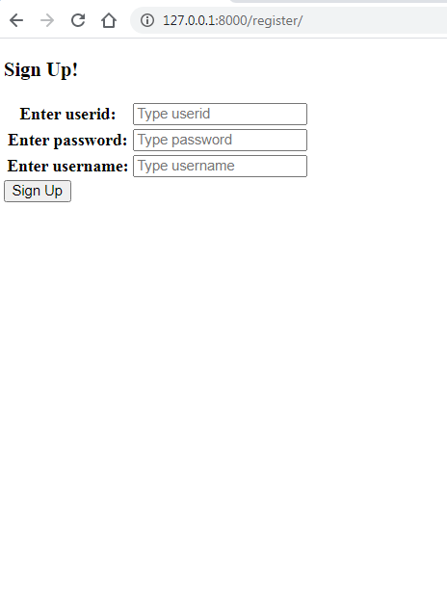
Output

Slide 20
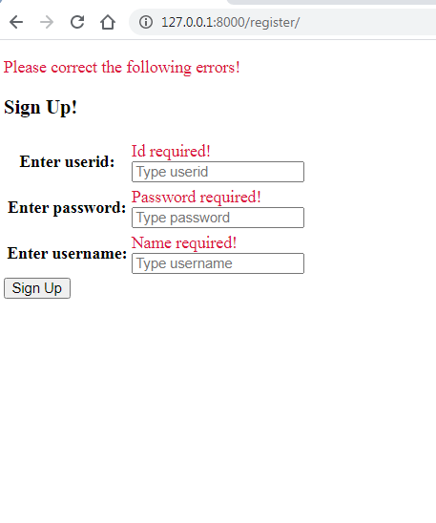
Output

Slide 21
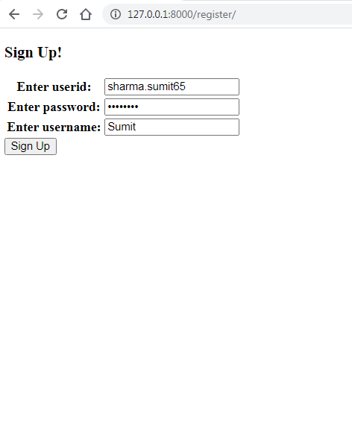
Output

Slide 22
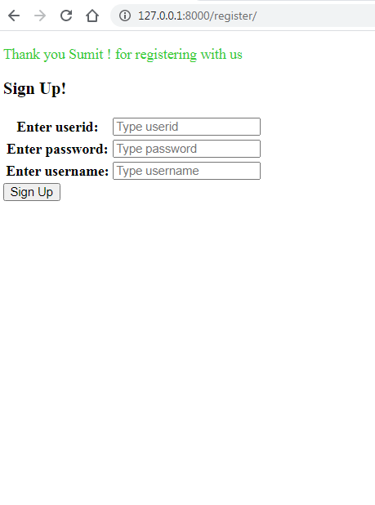
Output

